Slide 1
Journey at 2023 Wells Fargo Data Science Camp

Slide 2
Overview of the journey in this week
Platform Set-up (Google Colab)
Style Transfer Example (optional)

Slide 3
1-week journey
Day | Morning | Afternoon
Monday | Intro to Data Science/ Motivating examples for each session/Set-up in Google Colab | Python Programming
Tuesday | Intro to Models (Linear Models, Random Numbers and Distributions) | Advanced Modeling I (Neural Networks, tree-based model)
Wednesday | Advanced Modeling II (Neural Networks, tree-based model) | Project: introduction and data collect
Thursday | Project: model initialization and structure design | Project: Model parameter tuning and optimization
Friday | Project: Preparation and Final Presentation | Presentations of AI Startup and Team Neural Network Task; Wrap-up
All the teaching materials are given at: https://github.com/DSAISummerCamp/dscamp_public

Slide 4
1-week journey
Day | Morning | Afternoon
Monday | Intro to Data Science/ Motivating examples for each session/Set-up in Google Colab | Python Programming
Tuesday | Metaverse and Unity Game Experience | Intro to Models & Advanced Modeling I
Wednesday | Advanced Modeling II | Project: introduction and data collect
Thursday | Project: model initialization | Project: Model parameter tuning and optimization
Friday | Project Preparation | Project Presentation
All the teaching materials are given at: https://github.com/DSAISummerCamp/dscamp_public

Slide 5
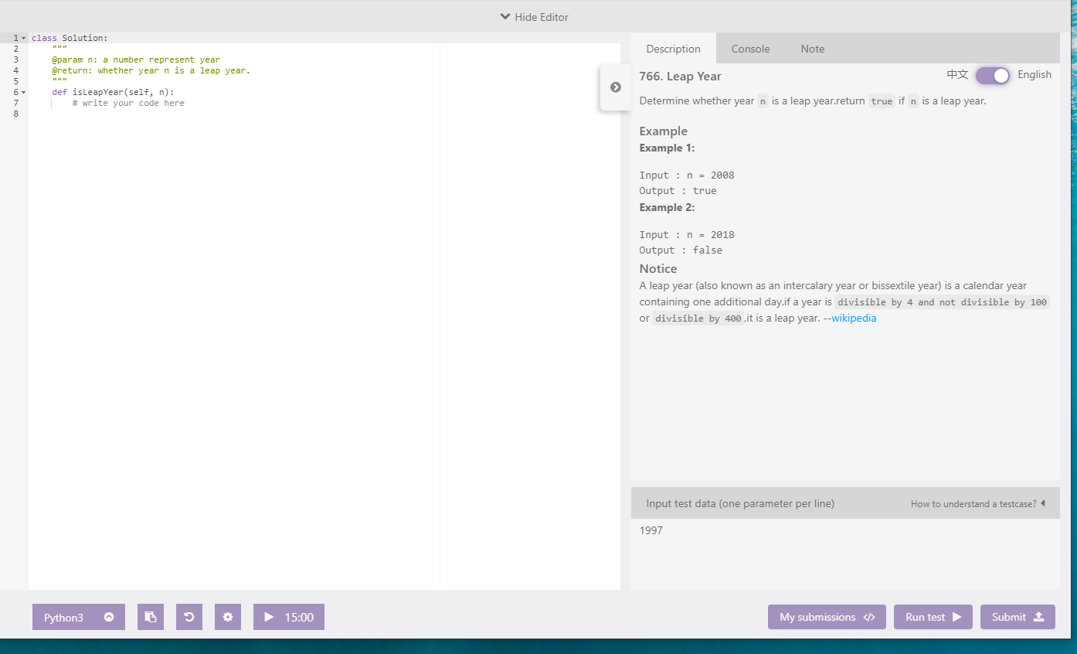
Python Programming- practice on lintcode (sign up a free account)
Github location:
https://github.com/DSAISummerCamp/dscamp_public/tree/master/Python%20Programming
www.lintcode.com

Slide 6
Advanced Model (Linear Regression to Neural Networks)
Part I: Linear Models
Part II: Neural Networks
Linear regression
Generalized linear models
Multilayer neural networks
Logistic regression
Single-layer neural networks
Convolutional neural networks
Tree based models
Github: https://github.com/DSAISummerCamp/dscamp_public/tree/master/Advanced%20Models%20I

Slide 7
Advanced Modeling (Neural Networks, tree-based model)
Linear regression
Generalized linear models
Multilayer neural networks
Logistic regression
Single-layer neural networks
Convolutional neural networks
Tree based models
NN: https://github.com/DSAISummerCamp/dscamp_public/tree/master/Neural%20Networks
Tree model: https://github.com/DSAISummerCamp/dscamp_public/tree/master/Tree-Based%20Models

Slide 8
Artificial Neural Networks Today
Where do we use this technology?

Slide 9
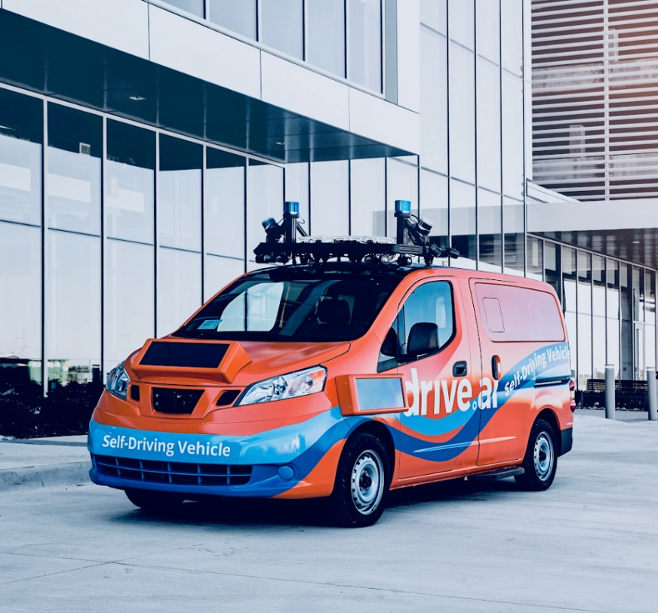
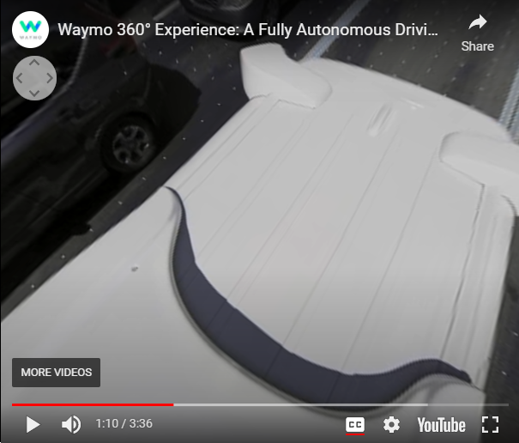
Artificial Neural Networks Today
AI Driving Cars
Self-driving vehicles are often powered by neural networks
Used to recognize objects on the road and to make decisions
https://medium.com/@andrewng/self-driving-cars-are-here-aea1752b1ad0
Link to video: https://www.youtube.com/watch?v=B8R148hFxPw

Slide 10
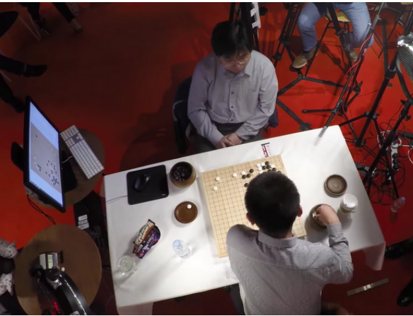
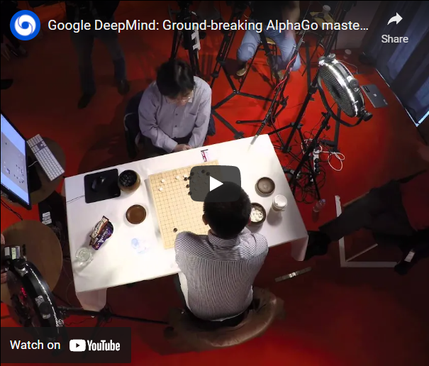
Artificial Neural Networks Today
AI Playing Go
Over a googol times as many board states as chess
Intuitive play
DeepMind defeated first ranked player Ke Jie in May 2017
https://blog.google/technology/ai/alphago-machine-learning-game-go/
Link to video: https://www.youtube.com/watch?v=SUbqykXVx0A

Slide 11
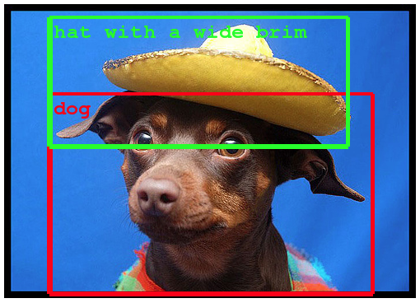
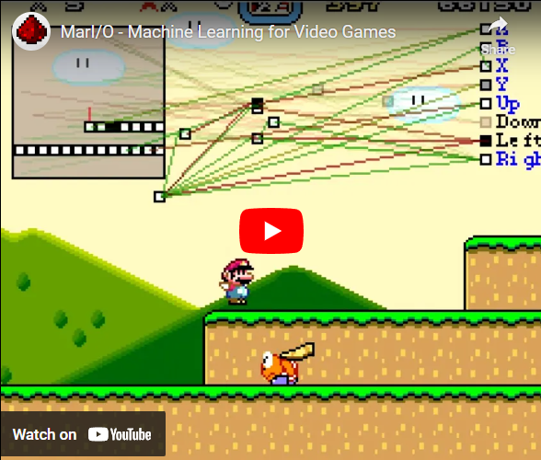
Artificial Neural Networks Today
Object Recognition
Learn to recognize objects in complicated images, videos, or even video games
https://ai.googleblog.com/2014/09/building-deeper-understanding-of-images.html
Link to video: https://www.youtube.com/watch?v=qv6UVOQ0F44

Slide 12
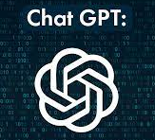
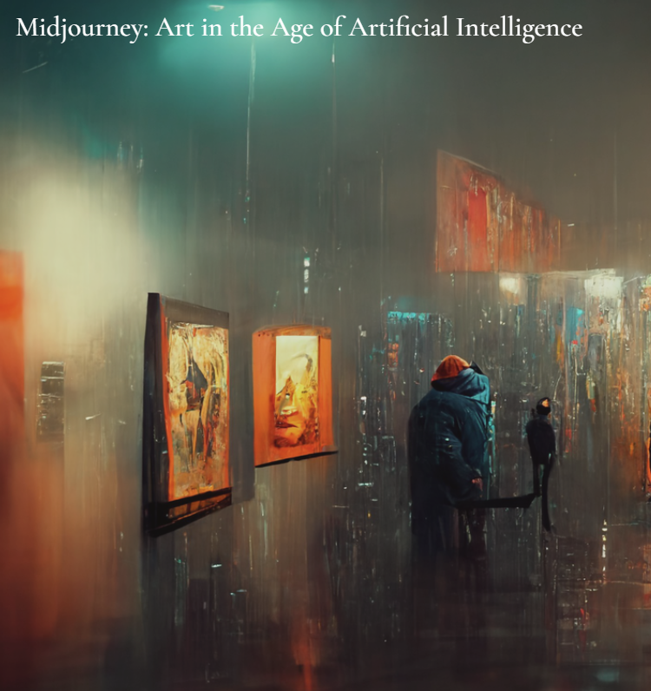
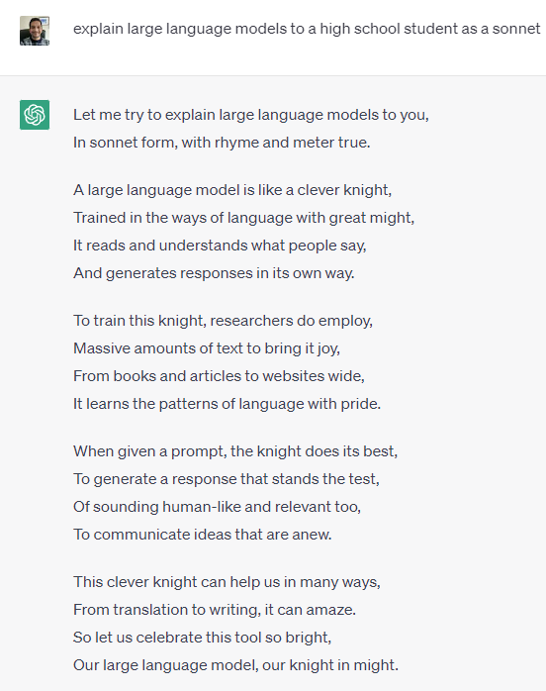
Artificial Neural Networks Today

Slide 13
Convolutional Neural Networks

Slide 14
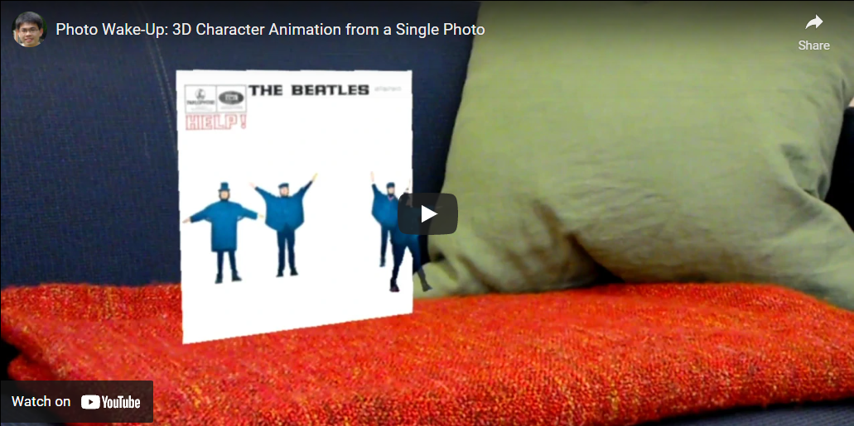
Convolutional Neural Networks Applications
Photo Wake-Up
Link to video: https://youtu.be/G63goXc5MyU

Slide 15
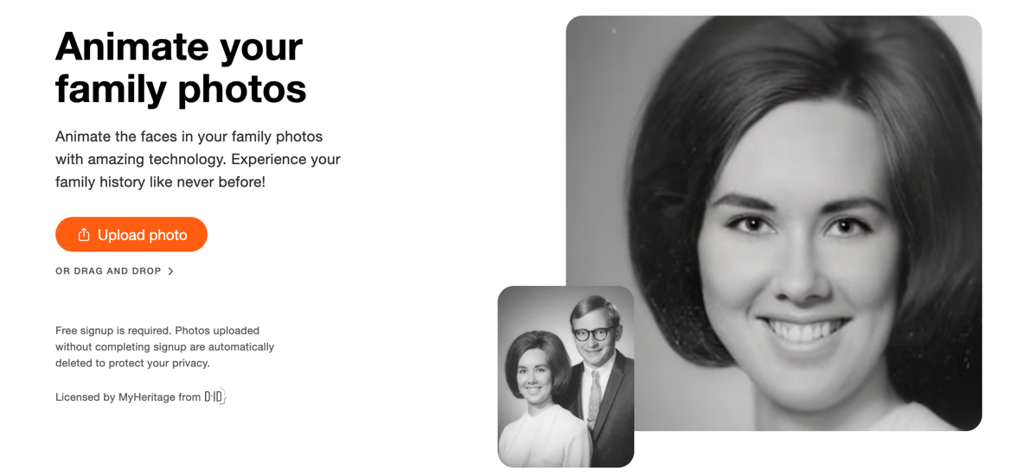
Convolutional Neural Networks Applications
Deep Nostalgia
By MyHeritage
Animates (old) photos
Went viral in February 2021
https://www.myheritage.com/deep-nostalgia
https://blog.myheritage.com/2021/02/deep-nostalgia-goes-viral/

Slide 16
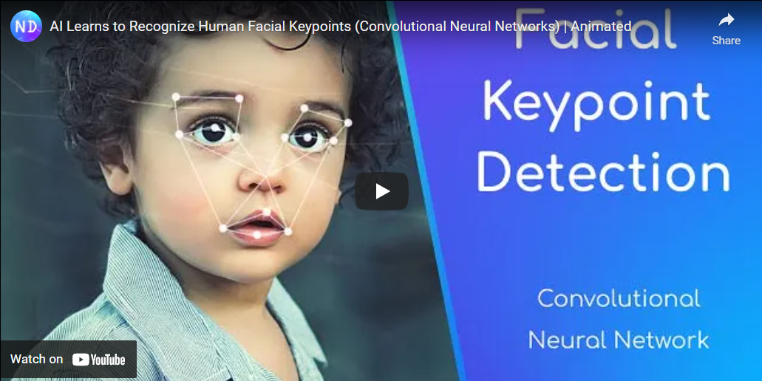
Convolutional Neural Networks (Optional) Applications
Facial Recognition
Link to video: https://www.youtube.com/watch?v=vC3bTziLRTA

Slide 17
Natural language processing (NLP)

Slide 18
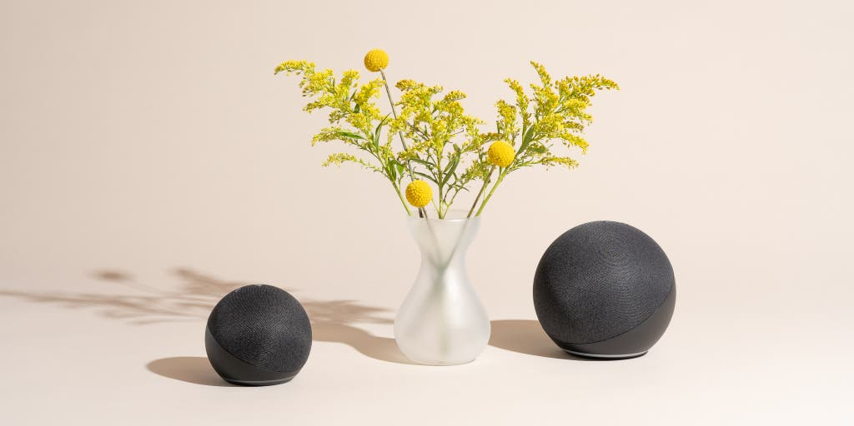
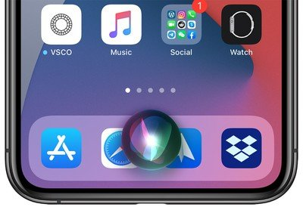
Amazon’s Alexa, Google’s Home, SIRI

Slide 19
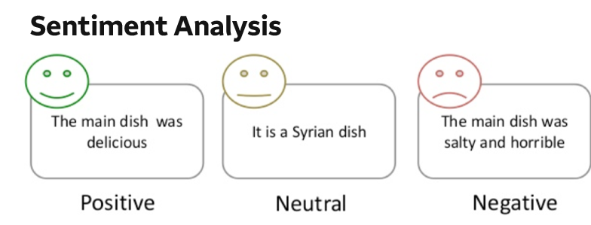

Slide 20
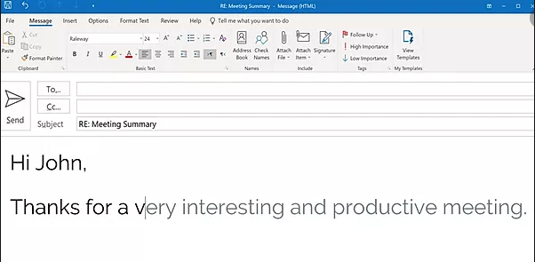
Speed up word processing and facilitate text dictation

Slide 21
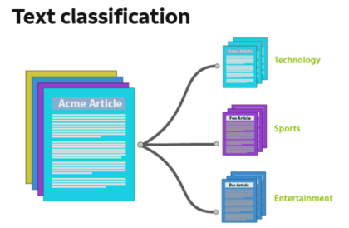
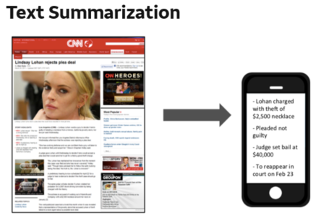

Slide 22
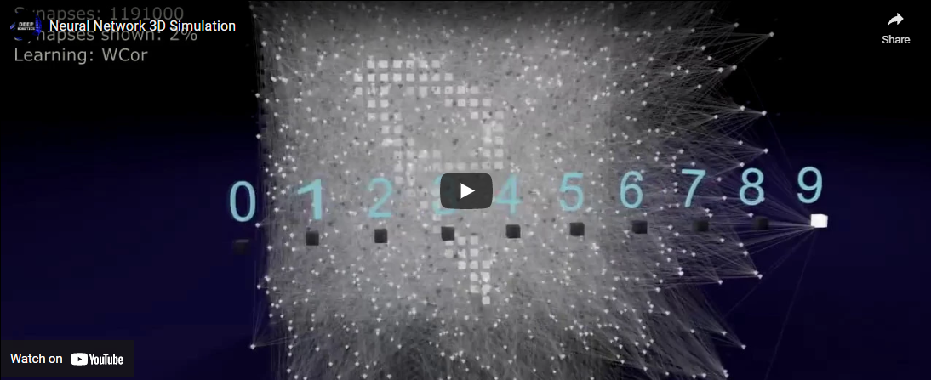
Neural Network Simulation
Link to video: https://www.youtube.com/watch?v=3JQ3hYko51Y

Slide 23
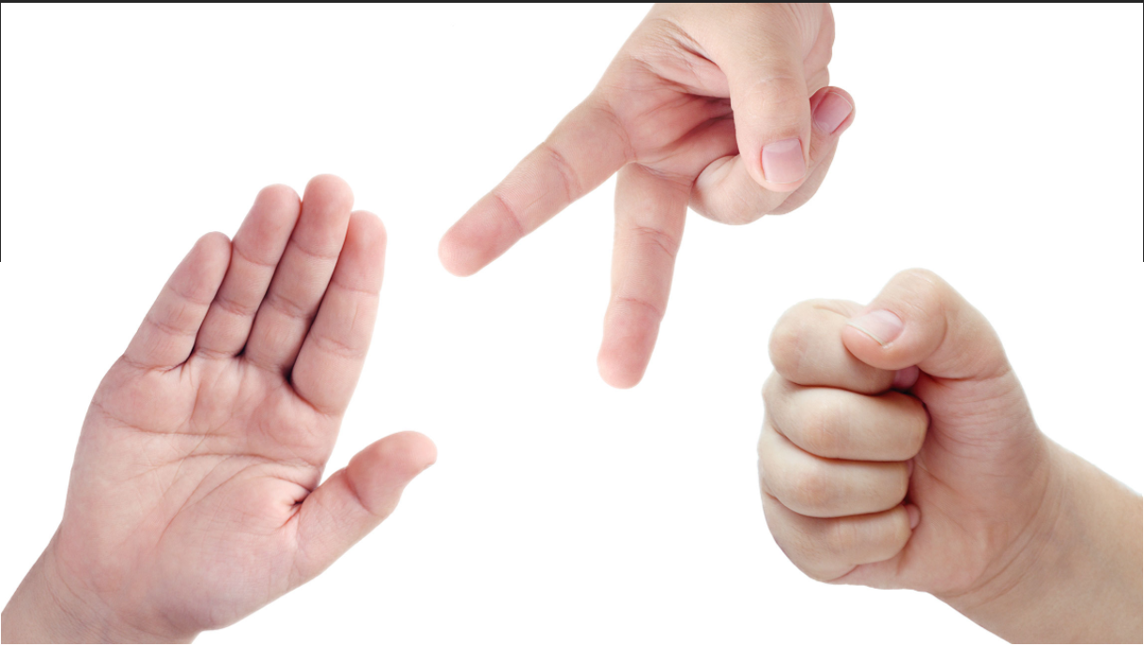
Final Team Project: Scissors, Rock and Paper Image Recognition
Github location:
https://github.com/DSAISummerCamp/dscamp_public/tree/master/Project%20Object%20Recognition

Slide 24
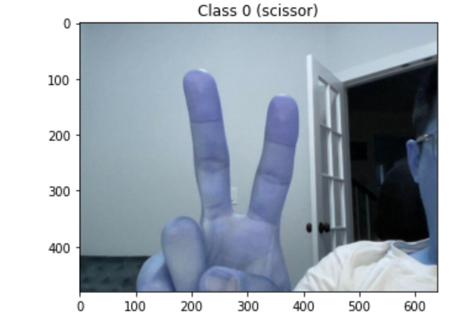
Final Team Project: Scissors, Rock and Paper Image Recognition
Team Task: build a Neural Network (NN) Model to recognize Scissor, Rock and Paper in images
Training Data needs to be collected by the students using the provided program to take pictures.
The basic structure of the NN is provided in a template.
Students need to try different model parameters, initializations, and optimization methods in order to have the best model performance.

Slide 25
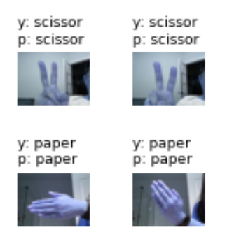
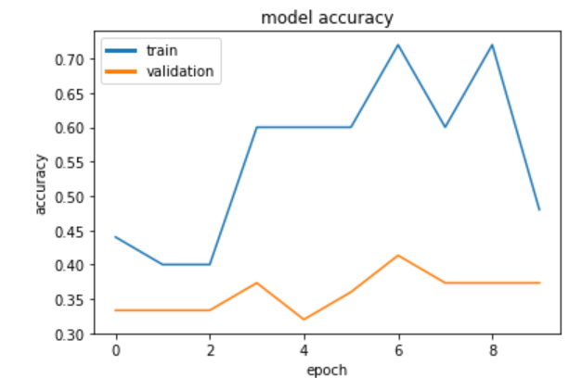
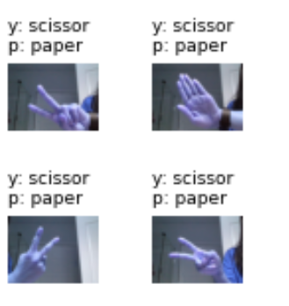
Final Team Project: Scissors, Rock and Paper Image Recognition
Assessment of performance: accuracy on a provided testing data set
Presentation Template is also provided
Right prediction
Wrong prediction

Slide 26
Final Team Project: Scissors, Rock and Paper Image Recognition
Project: introduction and data collect
data_prep.ipynb
Team project for NN.pptx
Project: Model initialization and structure design
pt1_Weight_Initialization.ipynb
pt3_Neural_Network_Example_CIFAR-10.ipynb
Project: Model parameter tuning and optimization
pt2_optimizer.ipynb
pt4_optimizer_example.ipynb
Github Location:
https://github.com/DSAISummerCamp/dscamp_public/tree/master/Project%20Object%20Recognition

Slide 27
Platform Set-up (Google Colab)
log out all of your google accounts (google drive , gmail, etc.) and log into one personal google account for this camp in google drive (drive.google.com)
Download Mounting_Drive_and_Cloning_Repository.ipynb from https://github.com/DSAISummerCamp/dscamp_public/tree/master/Colab_Setup
Save it in your google drive.
Select 'Mounting_Drive_and_Cloning_Repository.ipynb' file in google drive and open in Colab.
Run the cells in the notebook, following the directions. This should mount your Google Drive, and clone the rest of this repository into your drive, making all the camp materials easily accessible.
Log on to https://drive.google.com. You should see a new folder called dscamp, and within that folder should be a copy of this repository.
You can open any of the notebooks in the folder by Right Click -> Open With... -> Google Colabratory. You may need to click "OK" to connect to Colab the first time.

Slide 28
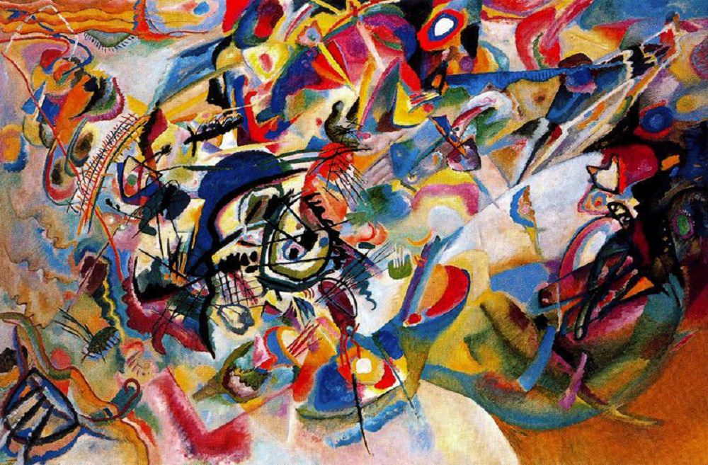
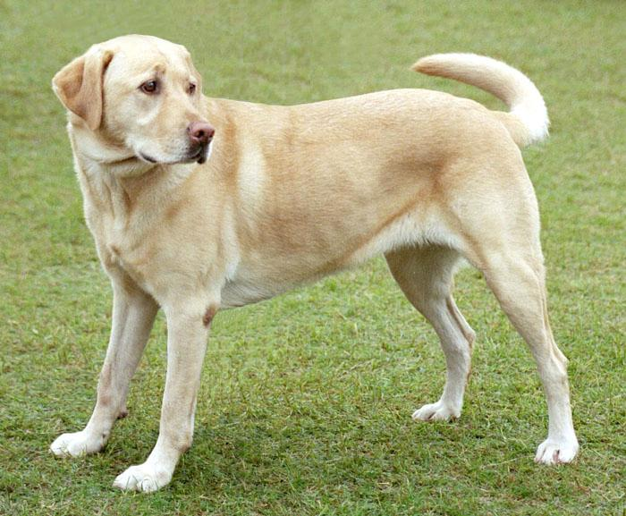
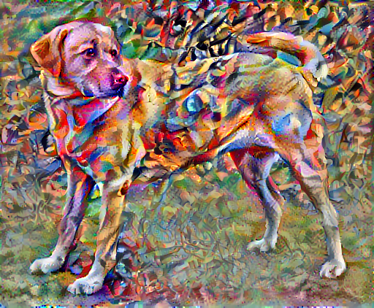
Style Transfer Example (optional)
+
=
Open: style_transfer.ipynb in google colab
https://github.com/DSAISummerCamp/dscamp_public/tree/master/Introduction%20to%20Data%20Science

